Slide 1


checkout
Presented by: Group 4

Slide 2
What is a checkout command?
In Git terms, a "checkout" is the act of switching between different versions of a target entity.
The checkout command lets you navigate between the branches created by git branch.
The git checkout command operates upon three distinct entities: files, commits, and branches.
The git checkout command may occasionally be confused with git clone.
.

Slide 3
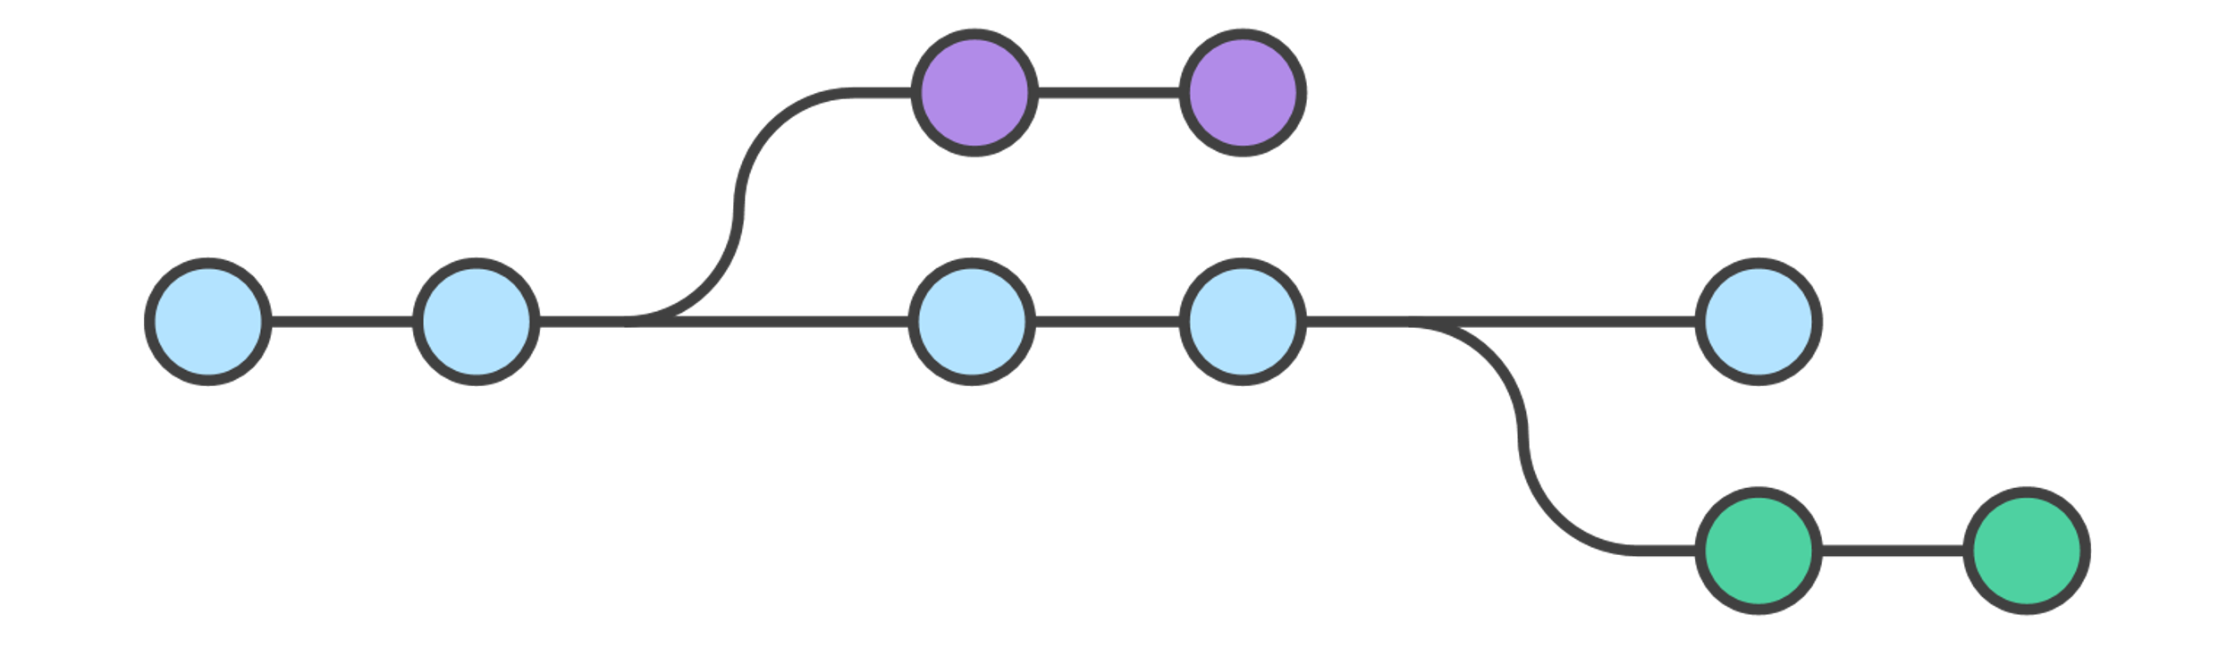
Fig: Branching using checkout

Slide 4
Why we use checkout?
Case1:
Issue fixing in other branch without polluting stable version.
Navigating to original branch is required after solution is fixed.
Case2:
It makes it possible to work on many unrelated features at the same time.
Git checkout makes it ridiculously easy to try new experiments without the fear of destroying existing functionality.

Slide 5
Basic Git Commands For Checkout
Switch between existing branches
git checkout <feature_inprogress_branch>
Create a new branch and immediately switch to it
git checkout -b <new_branch>
Checkout a new local branch and reset it to the remote branches last commit
git checkout -b git reset --hard origin/
Switch to the branch last checked out
git checkout

Slide 6
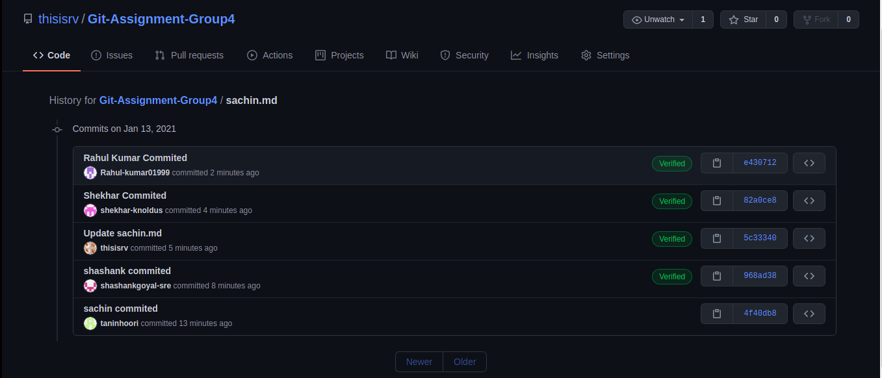
Commits by all team members
Link: https://github.com/thisisrv/Git-Assignment-Group4.git

Slide 7
What did we learn ?
Introduction to checkout command in Git.
Diagrammatic representation of how checkout work ?
How checkout command is useful ?
Basic Git checkout commands and their applications.
Collaborated on a public repository as a team.

Slide 8
Group 4 Members
1. Shekhar Yadav- shekhar.yadav@knoldus.com
2. Sachin Narang – sachin.narang@knoldus.com
3. Shashank Goyal – shashank.goyal@knoldus.com
4. Rishabh Verma – rishabh.verma@knoldus.com
5. Rahul Kumar - rahul.kumar@knoldus.com

Slide 9


